Slide 1
Why I have chosen each song for my FMP.

Slide 2
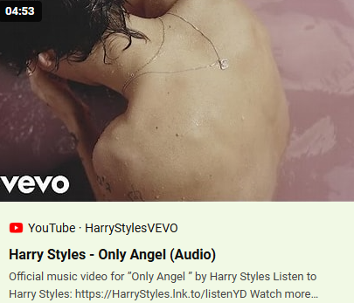
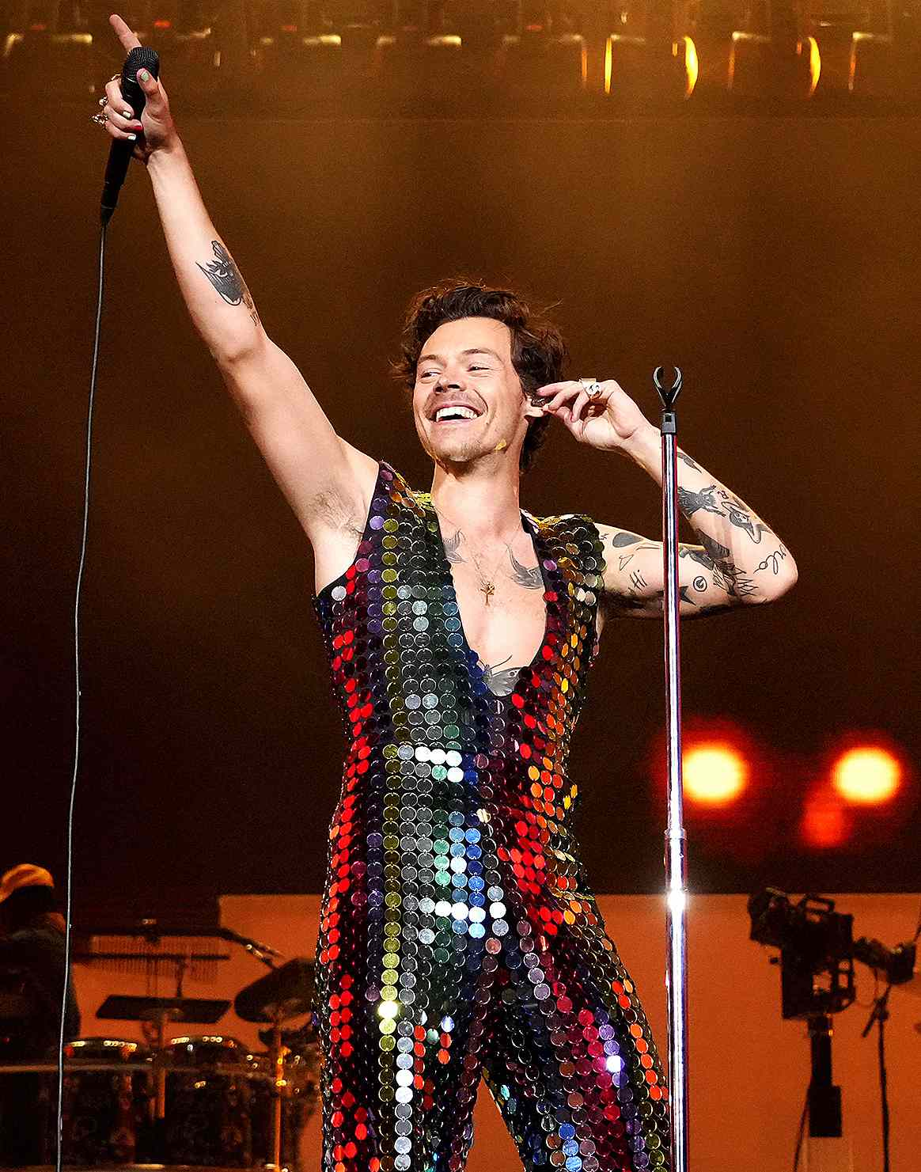

I have chosen each one of my songs for different reasons, this one is artist based. I wanted to do a Harry Styles song as he is someone who has helped me with my mental health without even realising through his music. He has done this by, being himself on stage and in his lyrics, in what he wears and his stage presence. When on stage he influences me to be myself and use the space on the stage because I know that after going to gigs of the effect he gives to the audience when being open and present on the stage.
Only Angel Live:
https://youtu.be/9Gqz8aSfAss?si=f-mL-WXE-n9QlECM
Only Angel- Harry Styles.
Date of release- May 12th, 2017
From the album- Harry Styles
Songwriters- Jeff Bhasker, Harry Styles, Tyler Johnson, Alex Salibian, Mitch Rowland, and Ryan Nasci.
Harry is someone who speaks about mental health very open, believing that it should be discussed and even doing that could save someone's life. There are many resources of evidence of him speaking about this subject, one I found particularly useful was: Everything Harry Styles Has Said To Guide You To Better Wellbeing - Capital
The album cover:

Slide 3
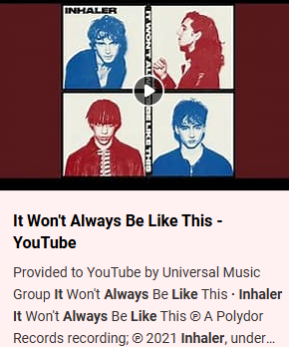
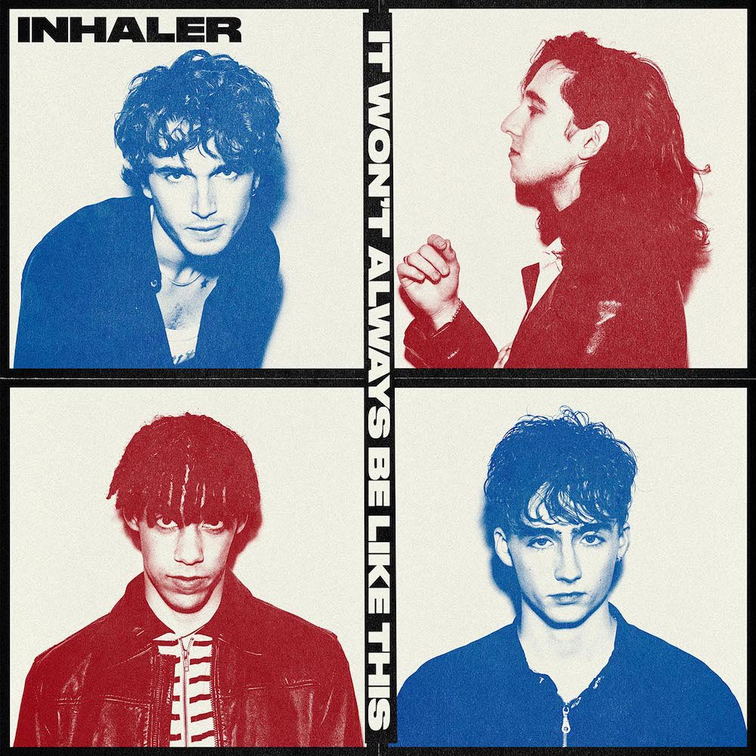
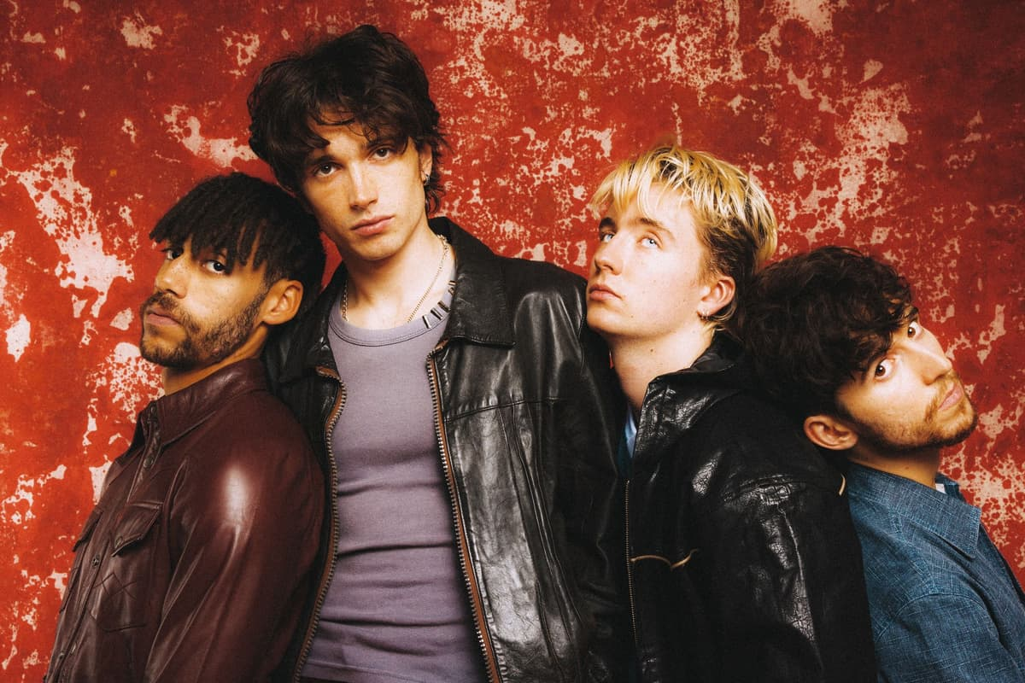
It won't always be like this- Inhaler.
From my personal interpretation of the song believe it represents somebody struggling and being manipulated in a relationship telling themselves as shown in the title "it won't always be like this." In the industry a manipulative partner can be detrimental, not surrounding yourself by the right people will never do yourself any good, having that extra bit of pressure is never a positive.
Date of release- July 9th, 2021
From the album- It won't always be like this
Songwriters- Ryan McMahon, Robert Keating, Joshua Jenkinson and Elijah Hewson.
The album cover:
Inhaler help me develop as a performer as I want to create music like them, so they show me how to present myself and interact with the audience.
It won't always be like this live:
https://youtu.be/8SjviApEdig?si=BoPLFbly5d33jrqy

Slide 4
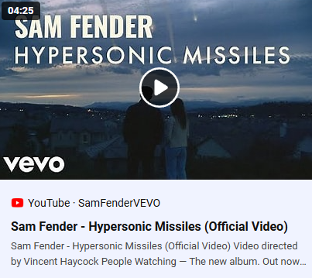
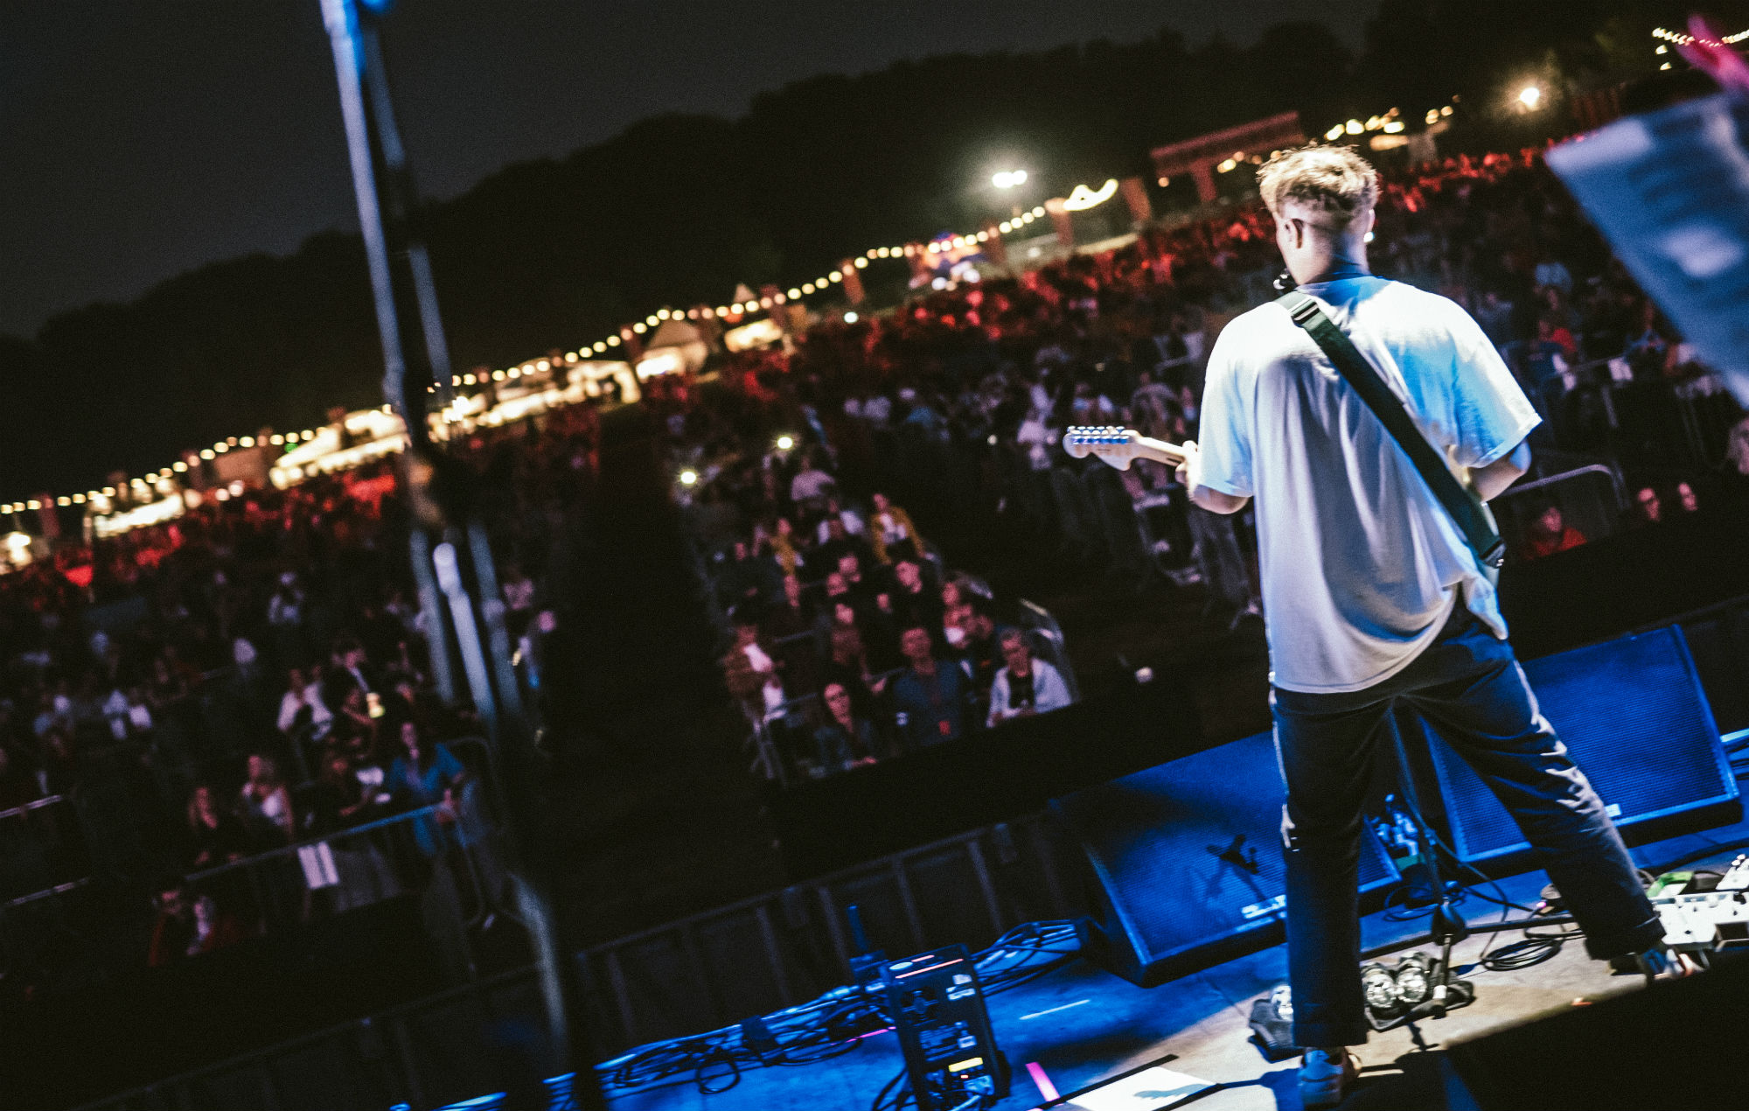
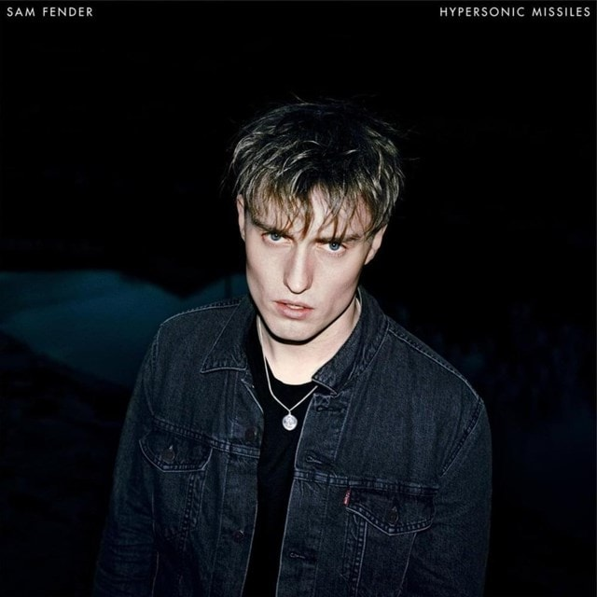
Hypersonic Missiles- Sam Fender
I then chosen this song as one of many takes on what is happening and relevant to the world right now, as a cause of mental health issues. The lyrics containing themes to do with war and people ignoring what is happening in the world.
Date of release- 13th of September 2019
From the album- Hypersonic Missiles
Songwriters- Sam Fender
The album cover:
Sam Fender has always been someone which I have aspired to be like, the way he interacts with the audience and his music makes the crowd feel like a big community supporting each other, that is a feeling I would love to give as a performer.
Hypersonic Missiles live:
https://youtu.be/EdRMoa1HhCk?si=yHzz0G1NyyUnmCJK

