Slide 1

Pop Rock Music

Slide 2

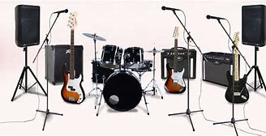
What is Pop Rock?
Pop rock music is the combination of two genres being pop and rock
Pop rock songs focus more on the songwriting than the instrumentation of the song.
Pop rock characteristics:
Use of guitar and drums
Lead vocalist
Songwriting
Audience appeal

Slide 3
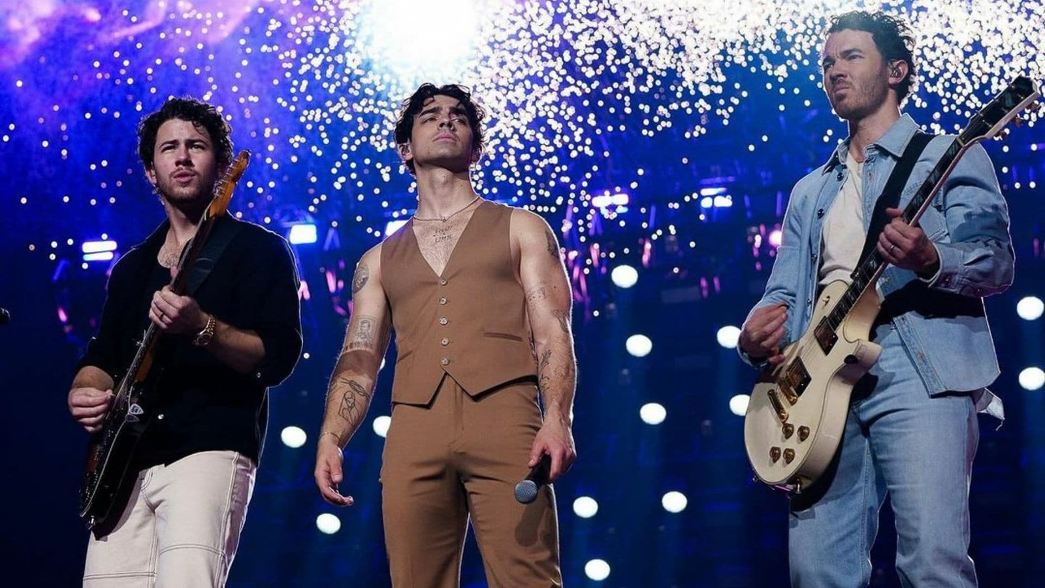
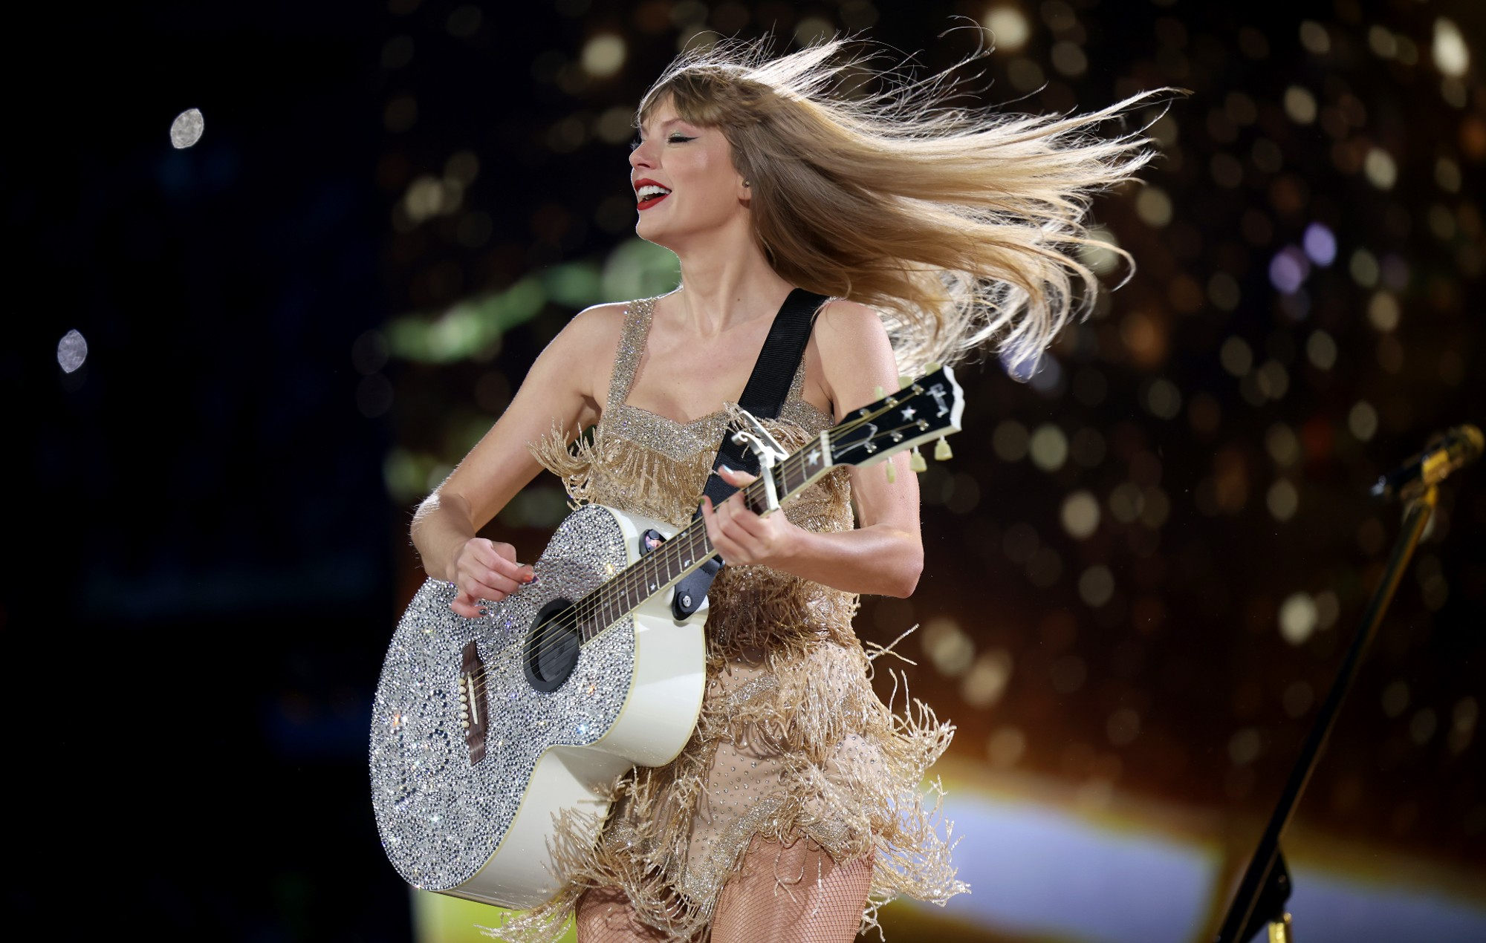
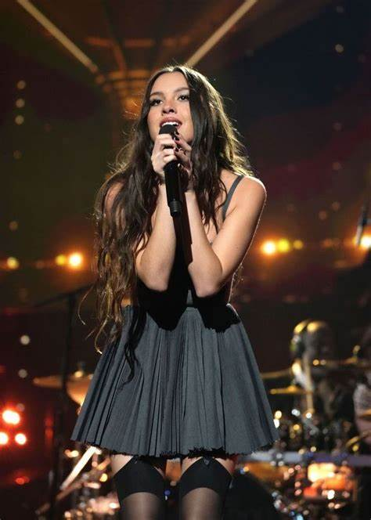
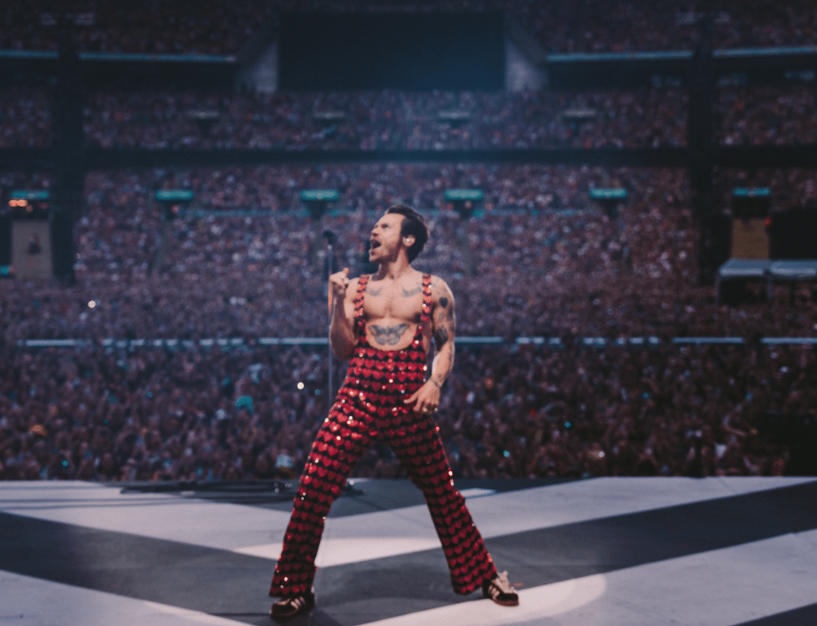
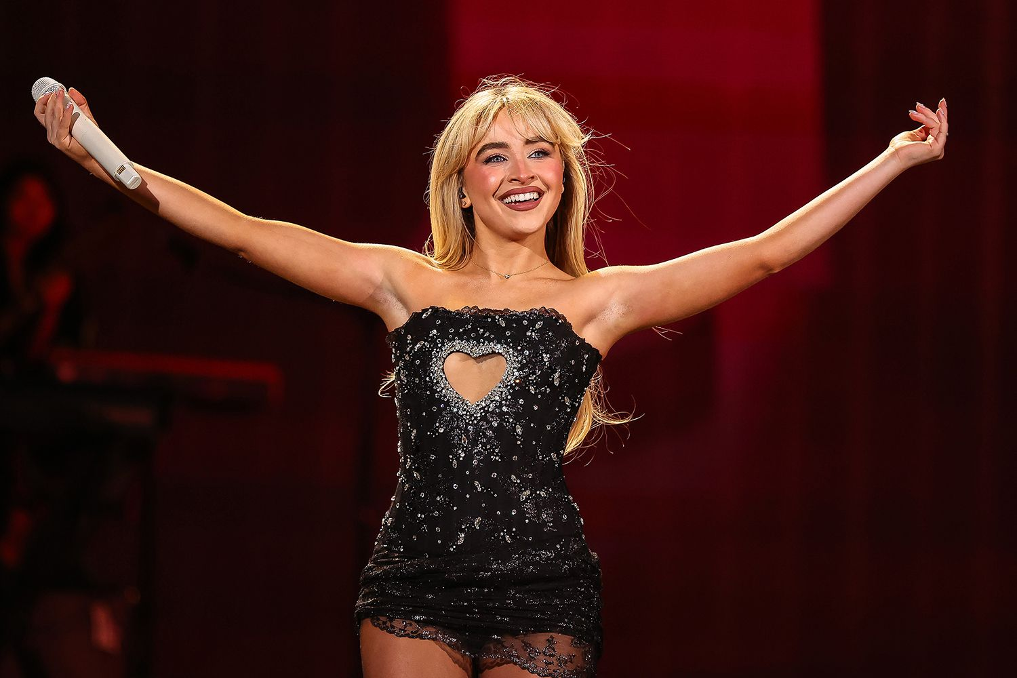
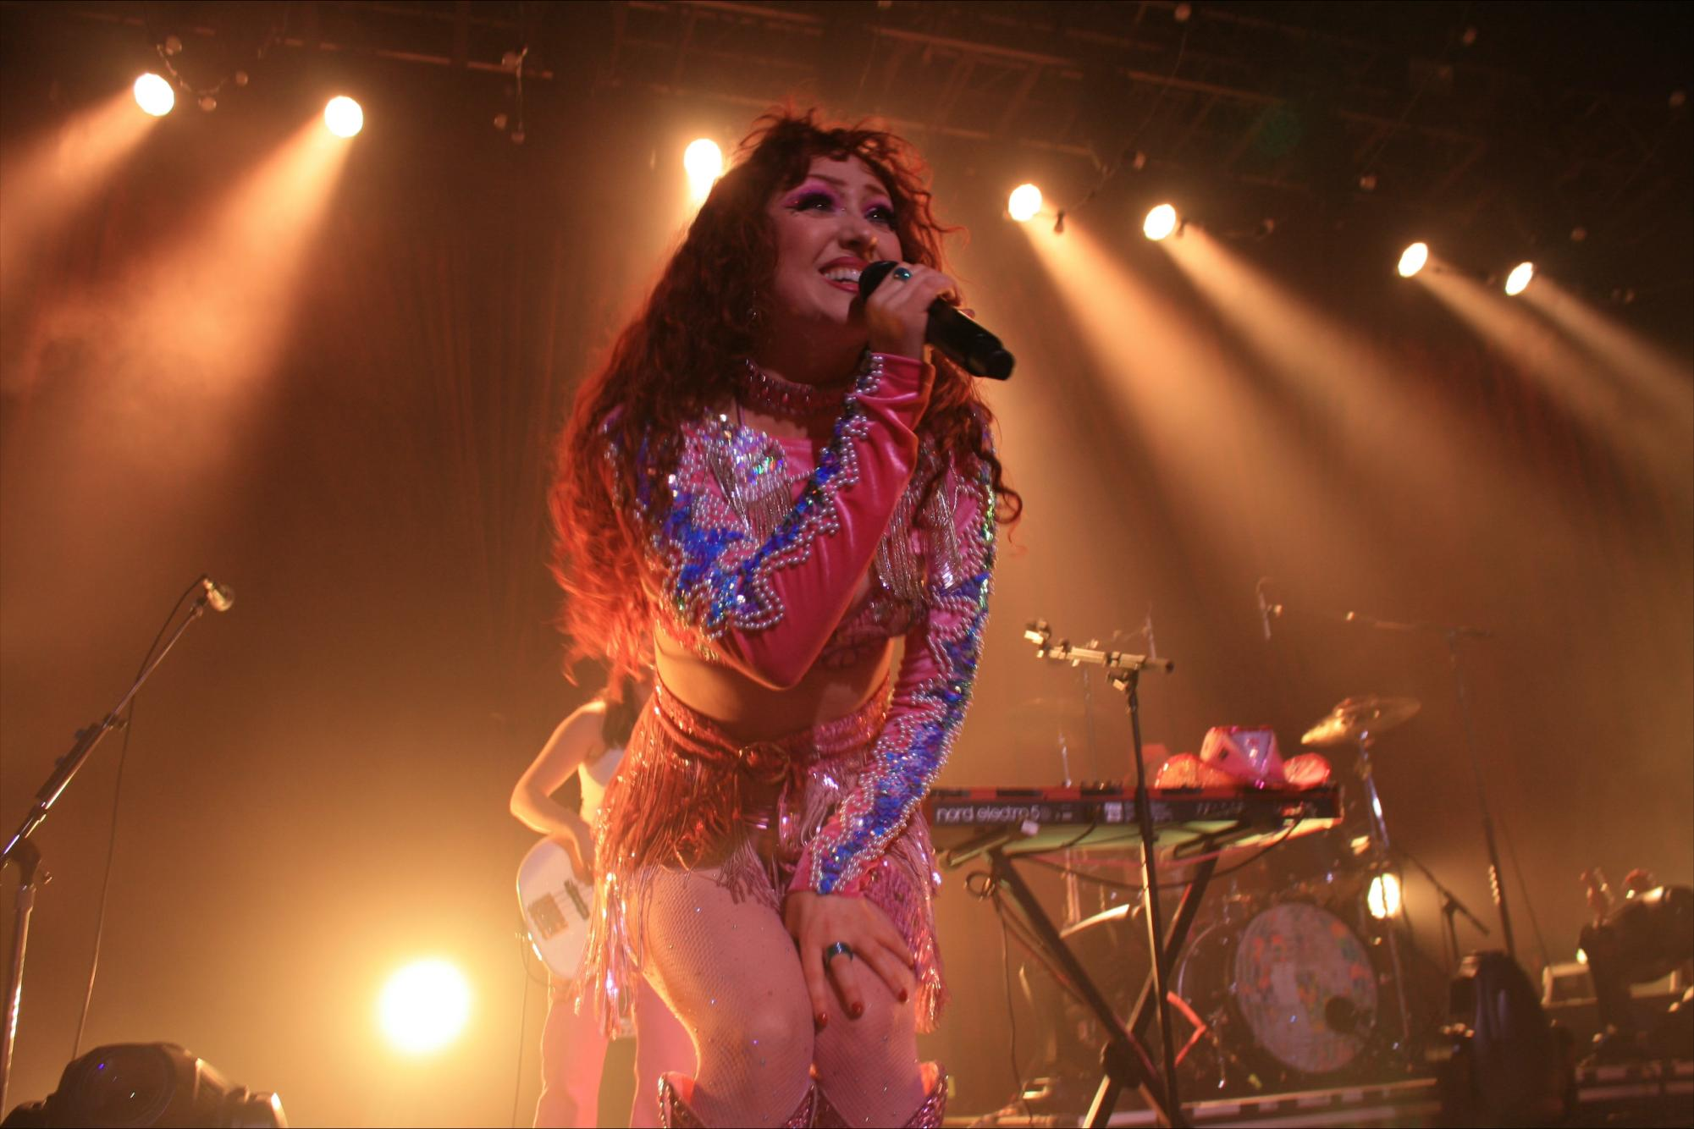
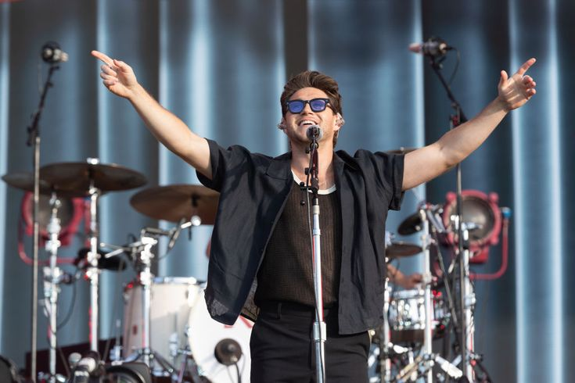
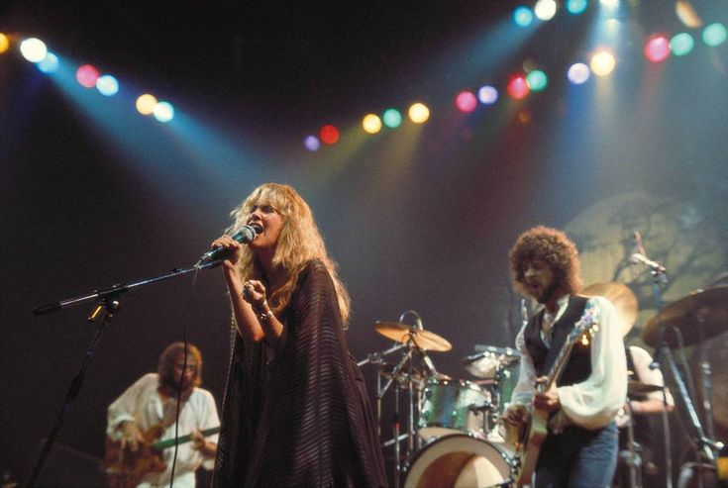
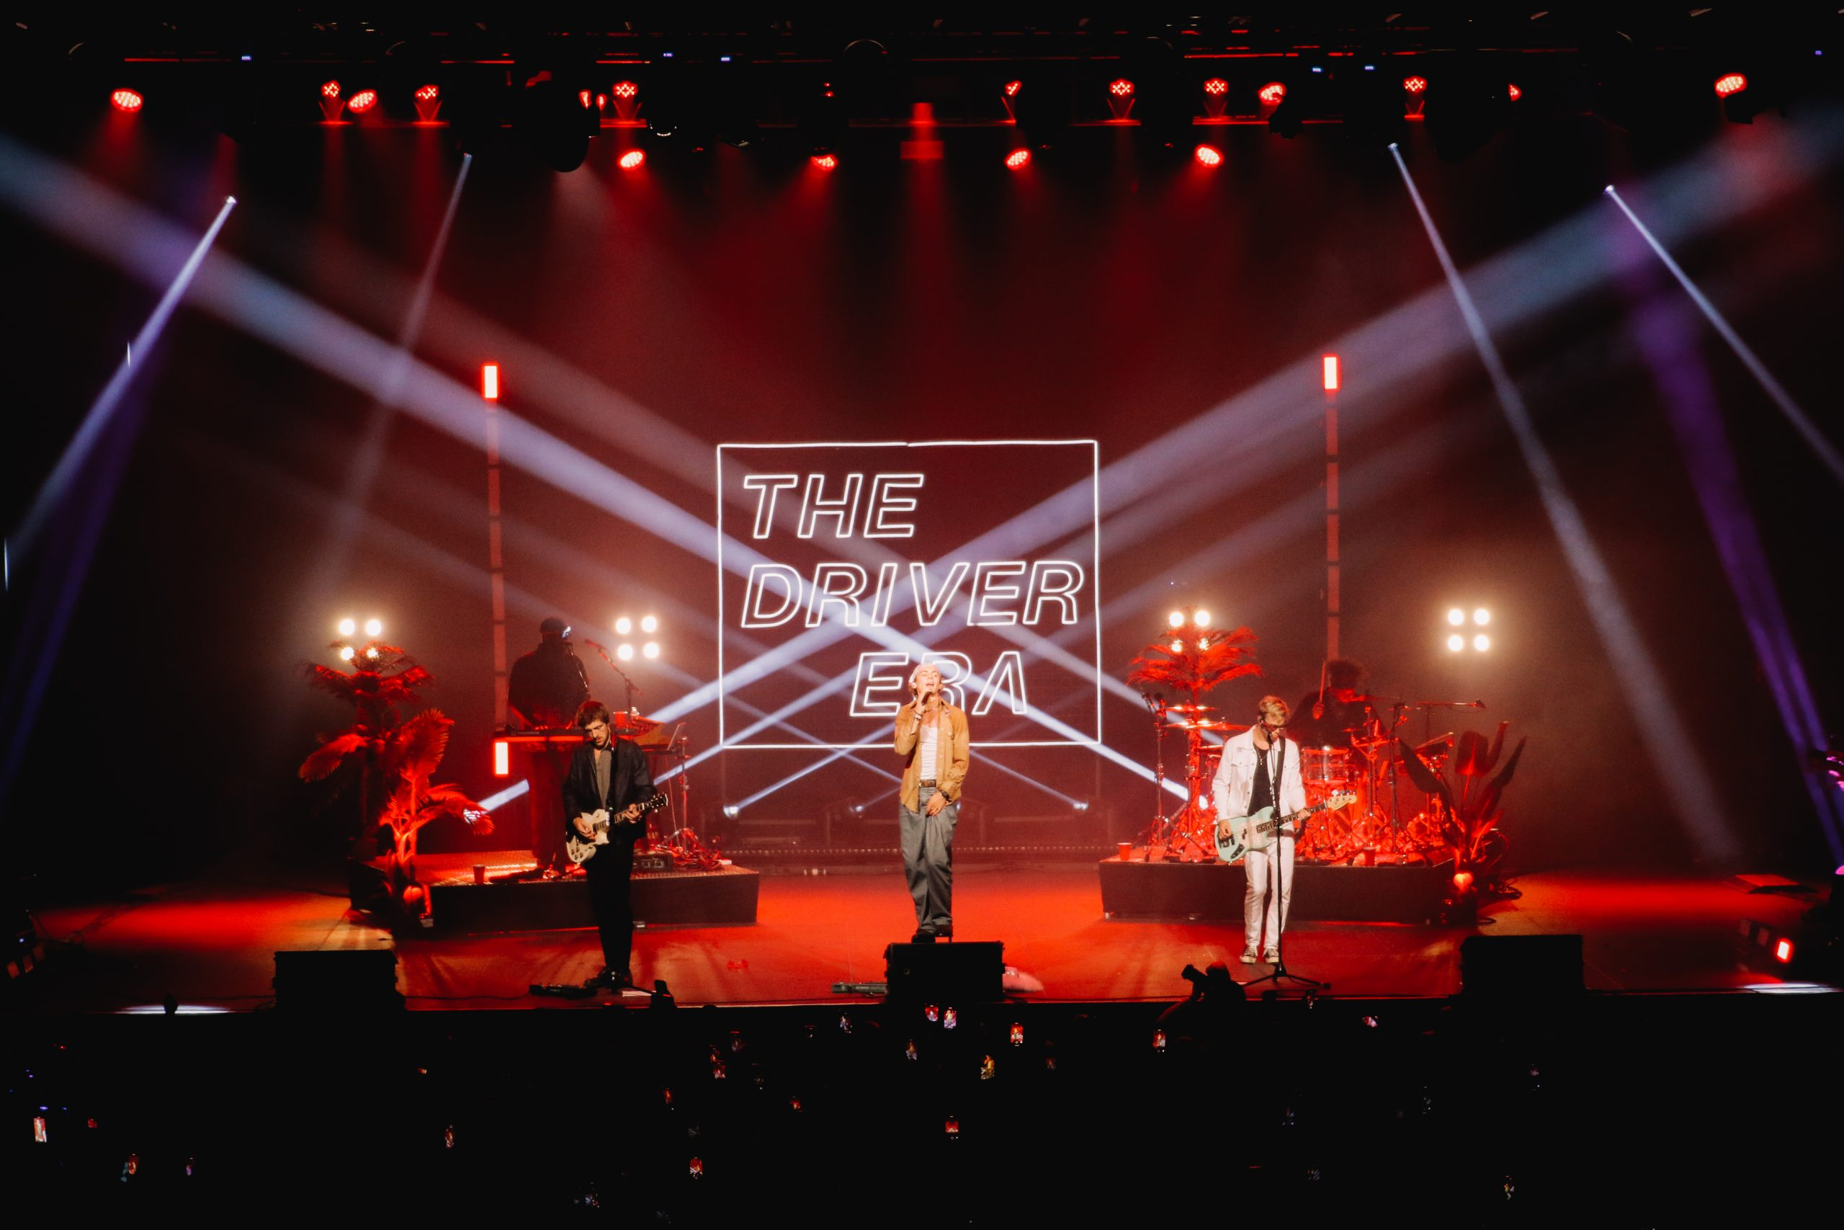
Why have I chosen this genre?
The reason I have chosen the genre pop rock is because, it is what I enjoy listening to the most. I listen to lots of artists, and they all manage to fall under that genre of which I would like to create music like one day.
After going to many concerts throughout the years seeing artists that do pop rock it made me fall in love with the genre even more and is the music that holds such good memories for me.
Some of my favourite artists are Harry Styles, Taylor Swift, Jonas Brothers, Olivia Rodrigo and Sabrina Carpenter just to name a small handful. For me, these people are examples that the pop rock genre allows you to be creative with the music that you make and experiment with it in so many ways to gain that unique sound.

Slide 4
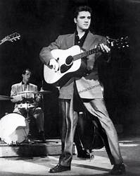
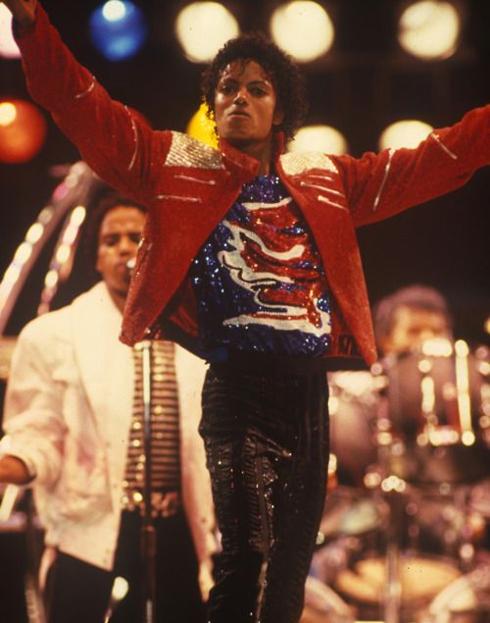
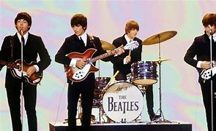
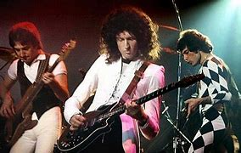
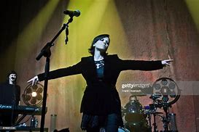
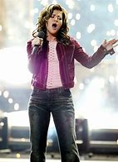
The 1950s
Pop music developed from show tunes, gospel songs and folk songs.
Elvis Presley changed the music industry by developing the rock genre from blues, making it a worldwide sensation.
The 1980s
This was when the pop genre reached its most popular point throughout the decades. So, artists really experimented in the pop rock genre using more synth sounds an example of this is Relax by Frankie goes to Hollywood.
History of pop rock
The 1960s
This is when The Beatles came onto the scene and changed the music industry starting with that rock n roll feel to their music then adding aspects of pop songs like more meaningful lyrics and equally focusing on lyrics and instrumentation.
The 1970s
Music develop even more and artists where experimenting even more and example of this would be Pink Floyd and their album Dark side of the moon.
The 1990s
RnB was on the rise in the 90s as well as the Britpop and indie genre however artists like The Cranberries and Nirvana where still producing pop rock music.
The 2000s – present
In the early 00s rock pop music was extremely popular as artists like Kelly Clarkson came onto the scene. Today pop rock is still a more well-known genre with meaningful lyrics as well as creative instrumentation.

Slide 5
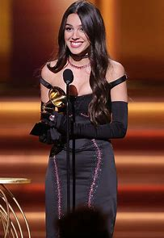
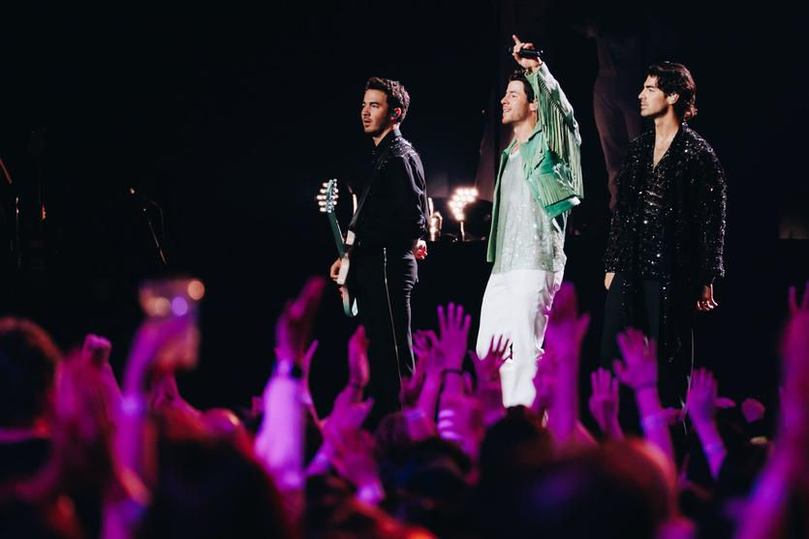
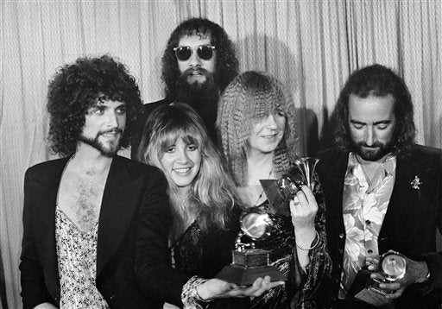
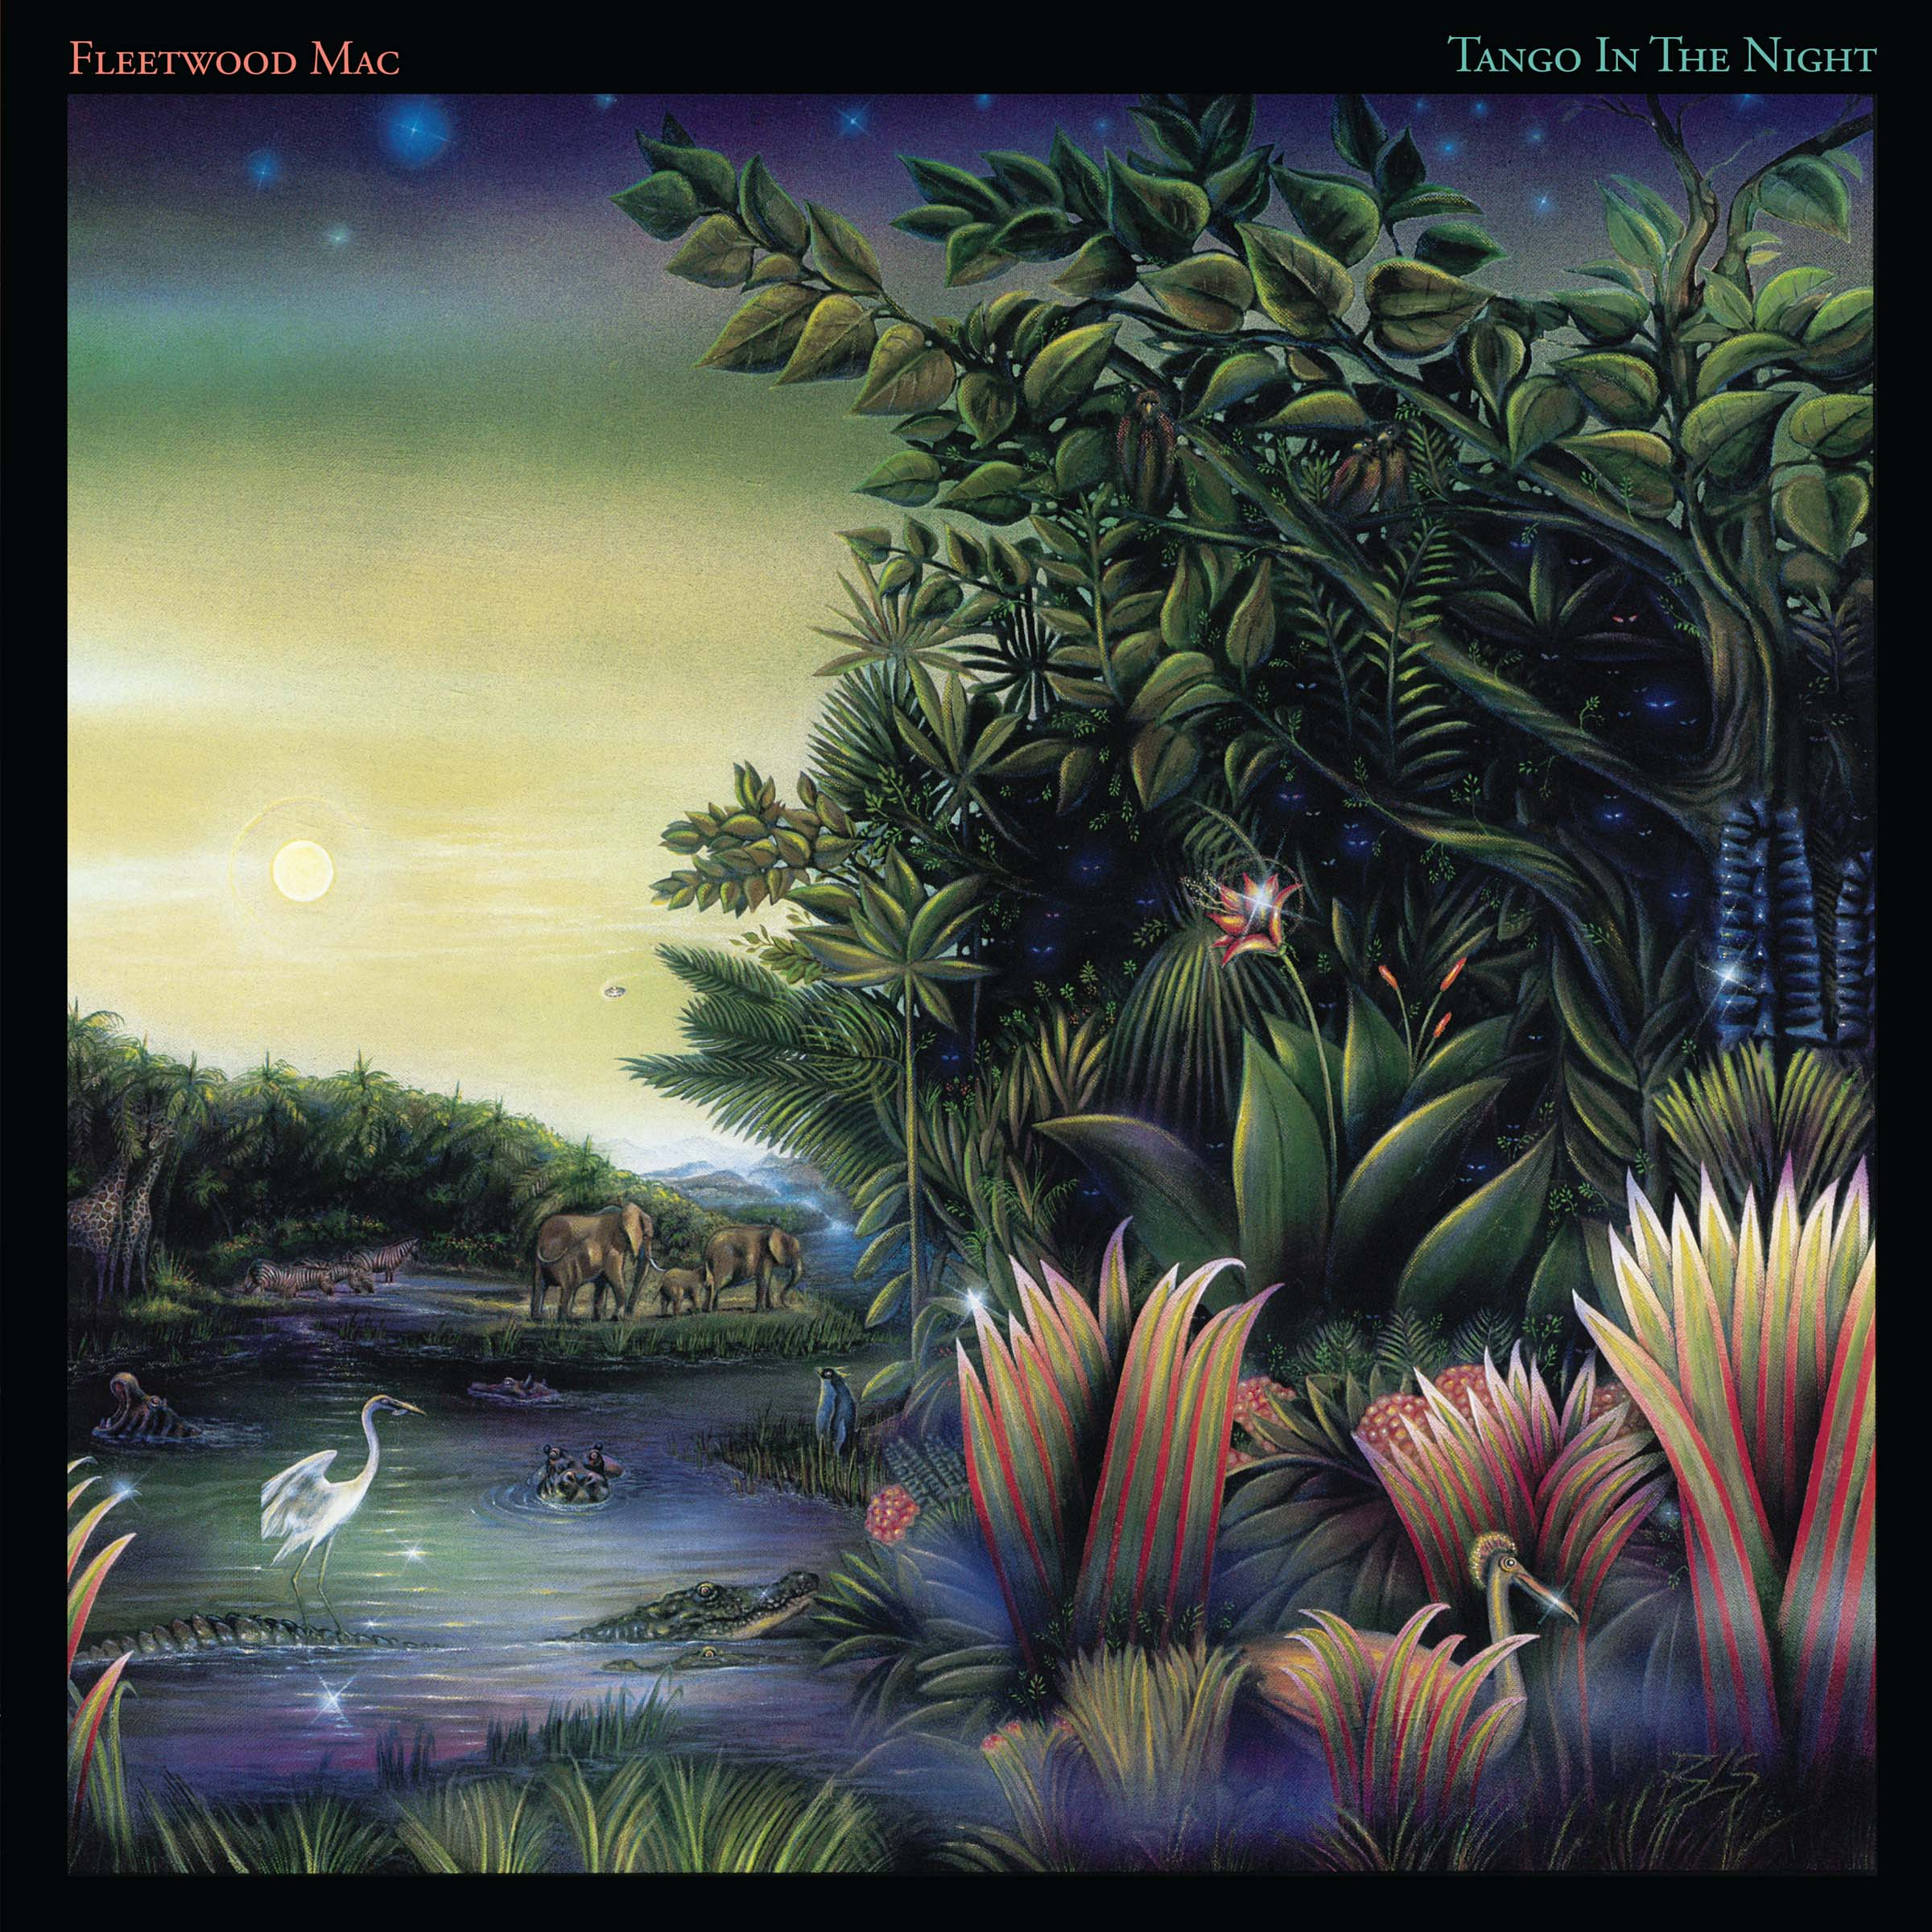
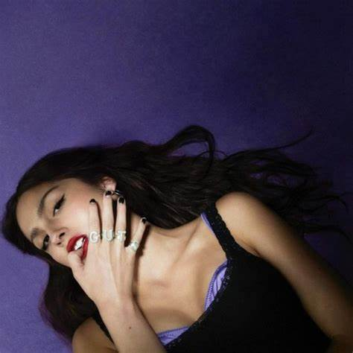
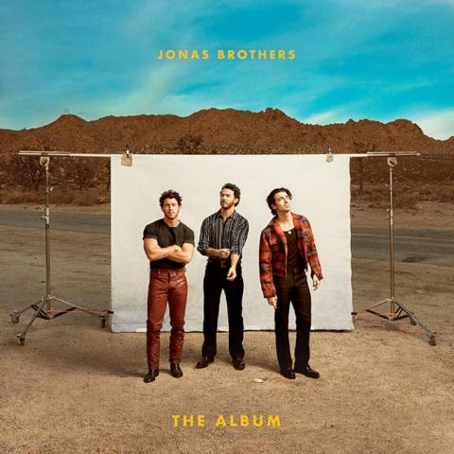
Artist inspirations for my song.
Olivia Rodrigo is one of my top artist inspirations when it comes to songwriting and stage presence.
Her songs are meaningful and vary from upbeat to more heartfelt ballads.
Her performance of "Your so vain" originally by Carly Simon is something I watch a lot to help me with my stage presence.
Songs that will influence my own song by her are 'So American' 'girl, I've always been' and 'love is embarrassing.'
The Jonas Brothers are also an inspiration regarding the song I will be composing, more so their work earlier in their career. Songs that will influence my composition are, 'SOS' 'Paranoid' and 'Cool.'
Fleetwood Mac are a band I have grew up listening to making it obvious for me to take inspiration from their songs some examples of this are, 'Little lies' 'Goldust woman' and 'Family man.'

Slide 6

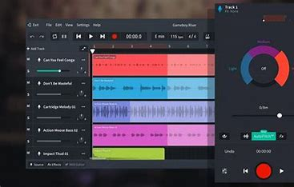

Composition of my song
To compose my song, I will be using band lab, I will also be listening to the songs on the previous slide for reference and support on how I want my song to sound.

Slide 7

References:
Pop Rock Music Guide: A Brief History of Pop Rock - 2024 - MasterClass
https://youtu.be/1-dT9r5nbks?si=OBQ7Px7Bp3wCxImf
https://youtu.be/W-PGNyhmSKA?si=q1FAFN_QtFJg3bUN
https://youtu.be/AXi213cWgYM?si=q3l_r6_Ofsafk8GK
BandLab - Make Music Online
https://youtu.be/W87Tmvu7iz8?si=LIE3cZ7FTXa66YO_
https://youtu.be/-Ti1b-RRBjI?si=X8nXJCNDrntvHvhY
https://youtu.be/I0voH4cU4ck?si=Gq11j36QAO32ScpO
https://youtu.be/EbBGkqll8lI?si=R1lCjrgpck4DgHJJ
https://youtu.be/9QyRspHyPxQ?si
https://youtu.be/8_JbZvHc92U?si=zPUkiOj22dQqa0be

