Slide 1
Preparing for the performance.

Slide 2
Warmups.
Bubbles.m4a - Doing this exercise has always helped me to warm up, doing it in scales as well as siren sound.
Four.m4a Four 1.m4a - The four sound, going from a higher key to a lower key helped me lower my larynx and is something which works the best for me when warming up, removing any tension I have in my throat.
I say no.m4a Hey.m4a - Both exercises prepare me best for when I am wanting to belt and can't quite reach it yet, if I do this and pretend that the words I am singing extend out it also helps me and gives me more room to sing them.
Aaa.m4a - Doing the basic 'a' sound in scales is something which is usually a part of my routine when warming up my voice before singing and is something that has always helped me as well as making me feel more prepared.

Slide 3
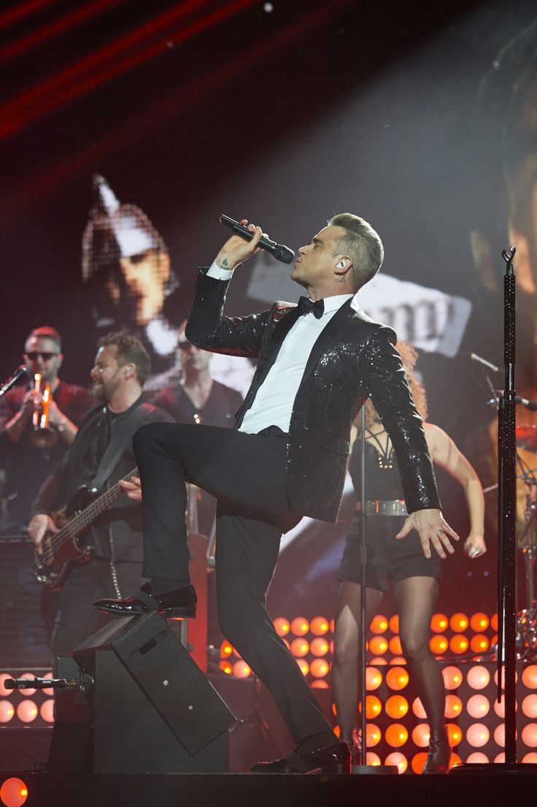
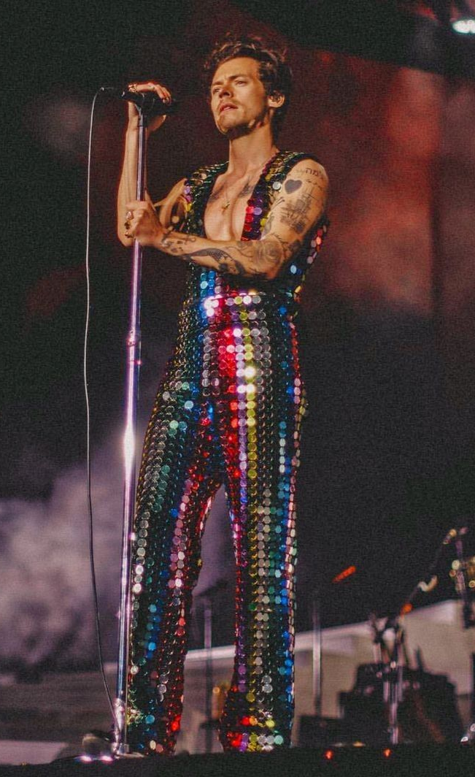
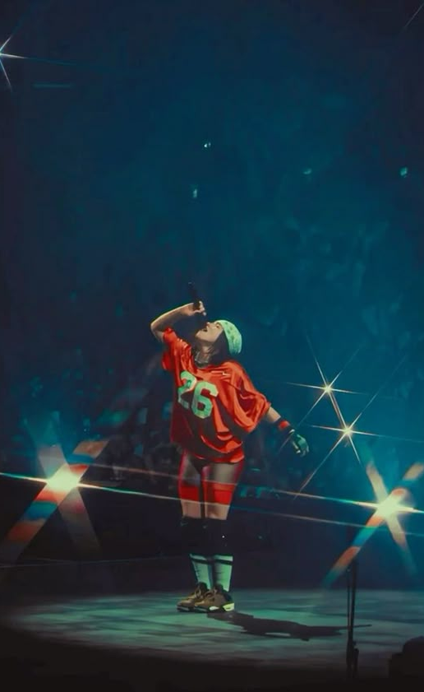
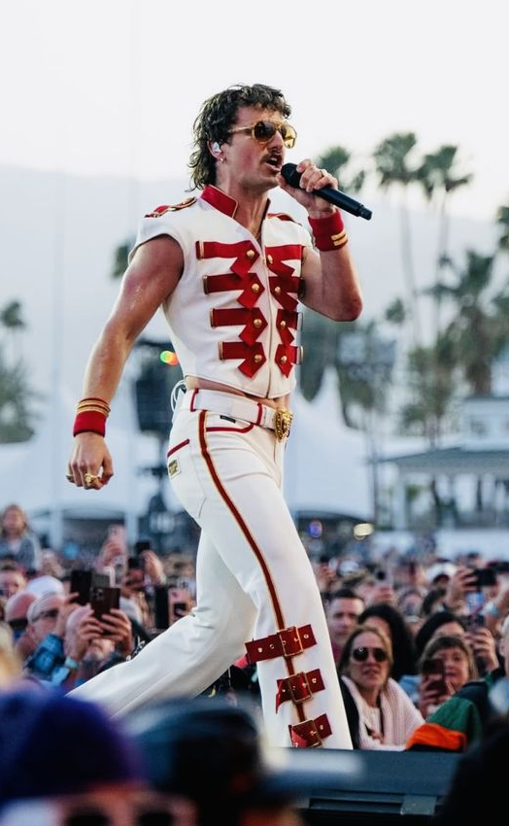
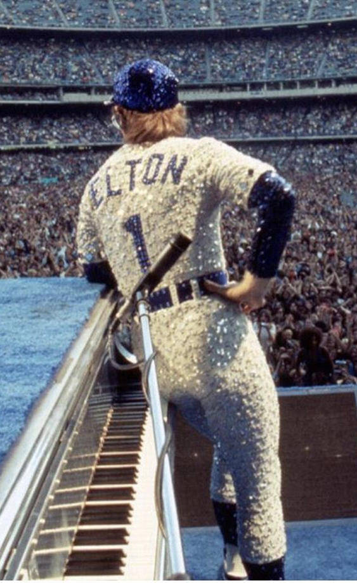
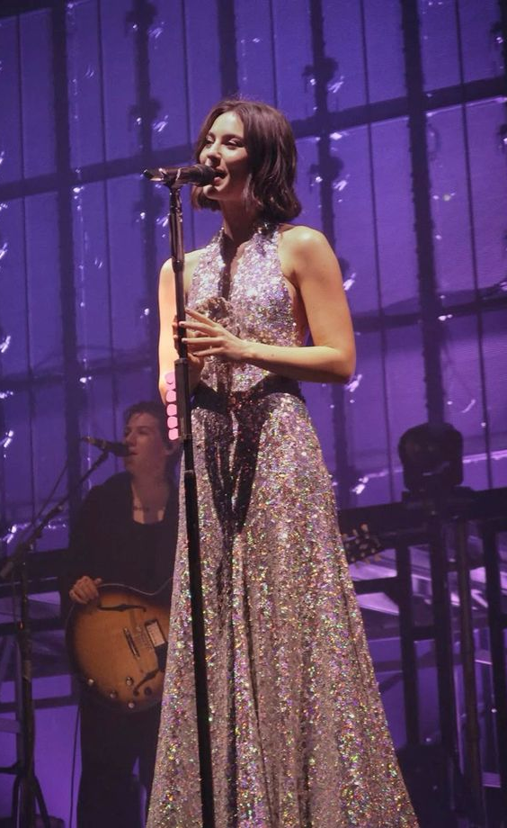
Artist Presentation.
How a performer presents themselves is very important, normally giving them a huge ounce of confidence before going onto stage and helping them get into their alter ego if they have one.
How an artist dresses also influences their fanbase and how they dress for example Harry Styles is very flamboyant when on stage, influencing his fans to wear bright colours, outfits with almost a 70s feel to them. The likes of Gracie Abrams dresses in a feminine way with dresses with the likes of sparkles or lace so her fans dress in that delicate way she presents herself.
I know that how you look in the industry is a big thing that is why I aspire to be different in the industry and what I wear for small gigs is important to me and makes me feel more prepared for a gig even if the audience don't care about it, feeling my best is the most important thing to me.

