Slide 1

Wellbeing in the industry-
Road to recovery

Slide 2

What will I be focusing on:
Wellbeing in the industry and why I have chosen this.
Artists that I will be research.
How I will put my research into practice.
My plan for performance.

Slide 3


Wellbeing in the industry.
Why have I chosen this topic?
Many artists in the industry have lost their lives due to mental health struggles and facing a battle with addiction.
Normal human feelings are never portrayed as common and important in the music industry.
Artists are always suffering in silence and never receive the support they need.

Slide 4
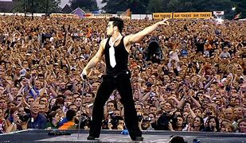
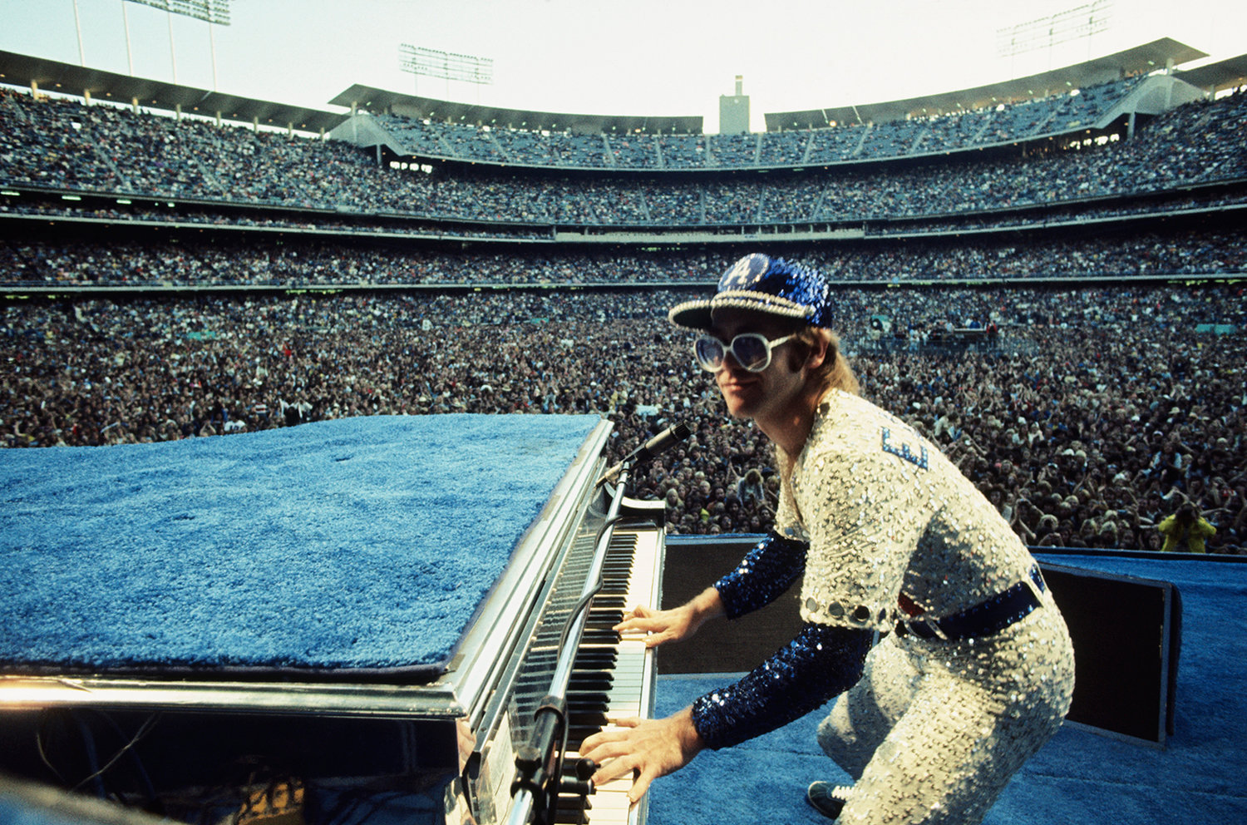
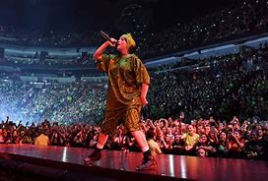
I have chosen to research these artists as they are all famous from different points throughout the years, Elton John in the 70s, Robbie Williams, 90s-00s, Billie Eilish present day. These three artists are also very open about their experiences with addiction, and depression, all being thrown in at the deep end at such a young age.
I will be researching about their personal experiences in the industry, watching documentaries and interviews where they have been open about their experiences. I will also be researching what they do to prepare for a show and how they avoid going back to old habits.
Artists I will be researching:
Robbie Williams
Elton John
Billie Eilish

Slide 5
How I will put my research into practice.
As I mentioned earlier, I will be researching what the artists do to prepare for a performance.
I will be doing a performance as part of my fmp therefore, I will do what these artists do to prepare for a performance finding out what works best for me.

